Slide 1
Hosia Maibelo Reserve Manager Groendal Wilderness Area
19 April 2024

Slide 2
FOCUS AREAS
Who we are?
Locality of Nature Reserves
Critical Careers and some Job Profiling
Opportunities (Field Rangers Academy)
Skills Development Program

Slide 3
WHO WE ARE?
ECPTA is an organization (public entity) responsible for the management of 21 state provincial nature reserves in the EC and also responsible for the promotion of tourism within the province of the EC.

Slide 4
PROVINCIAL NATURE RESERVES

Slide 5
WHAT ARE WE LOOKING FOR?

Slide 6
CRITICAL CAREERS
Field Rangers
Section Rangers/ Conservation Managers
Diploma in Conservation or related similar qualifications
Reserve Managers
Advanced Diploma in conservation or similar related qualifications
Ecologists/Bio-Technicians
Tourism Officers
Grade 12
Fire Arms Competency
Honours/ Masters in conservation or related qualifications
Diploma in Tourism or related similar qualifications

Slide 7
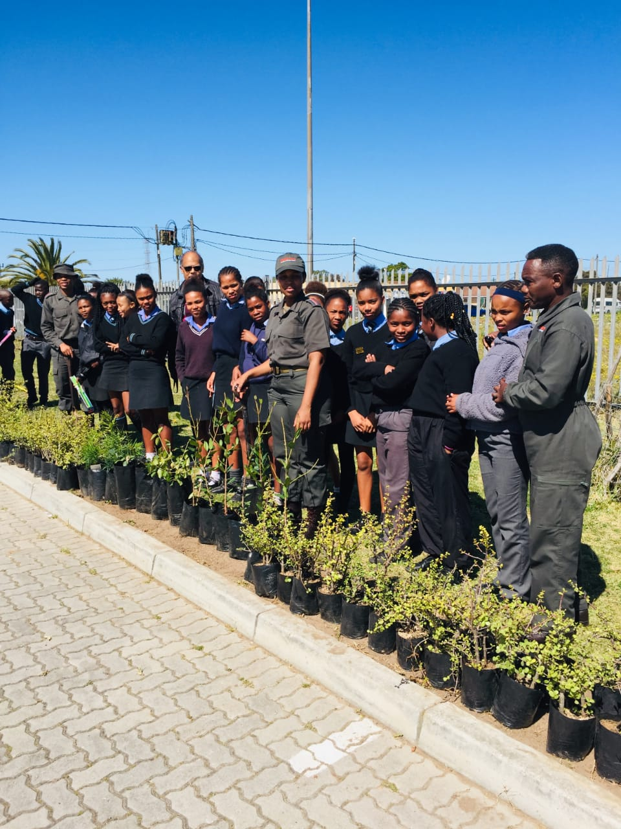
FIELD RANGERS
Area patrols
Law Enforcement
Fire Management
Biodiversity monitoring
Game Capture
Culling
Alien Species Control
Environmental Education

Slide 8
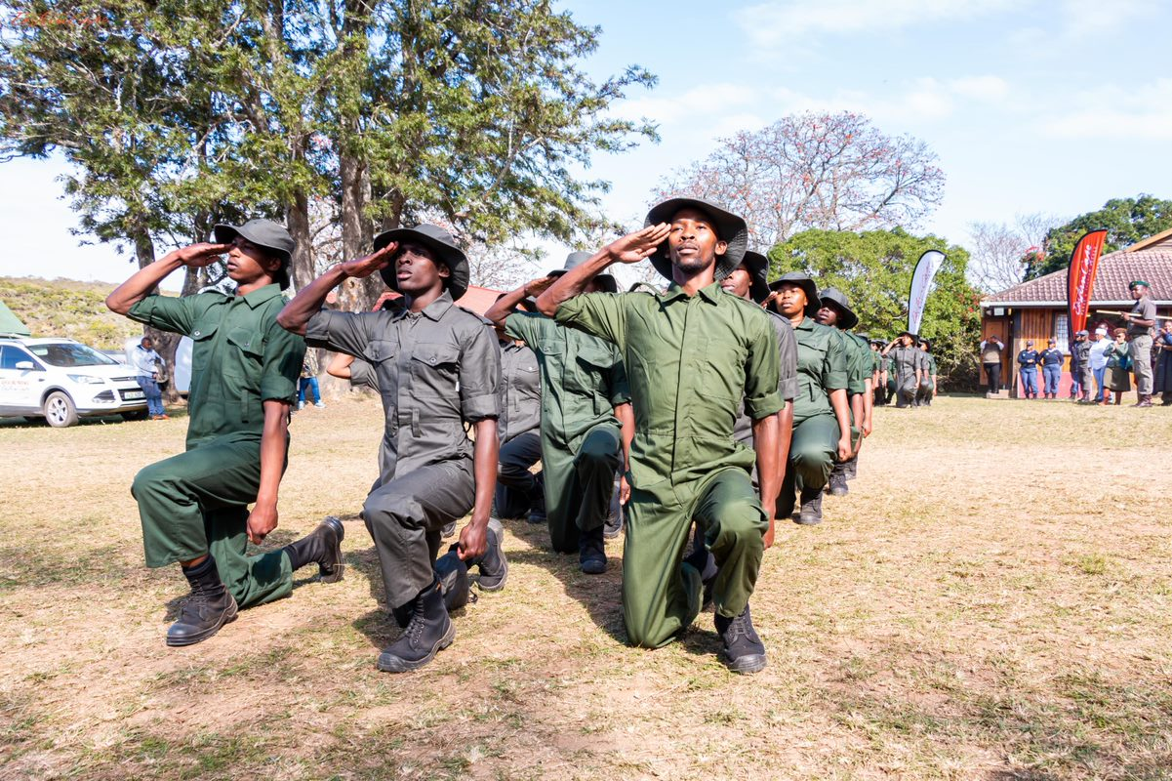
FIELD RANGER ACADEMY
Established a Field Ranger Training Academy in collaboration with Southern Wildlife College (Thomas Baines NR at Makhanda).
Recruit from local communities adjacent to Nature Reserves.
45 trained so far and 34 absorbed into permanent positions.

Slide 9
RESERVE MANAGERS
Leadership
Implementation of strategic plans
Ecological Management
Stakeholder Engagements
Administration and Reporting
Financial Management

Slide 10
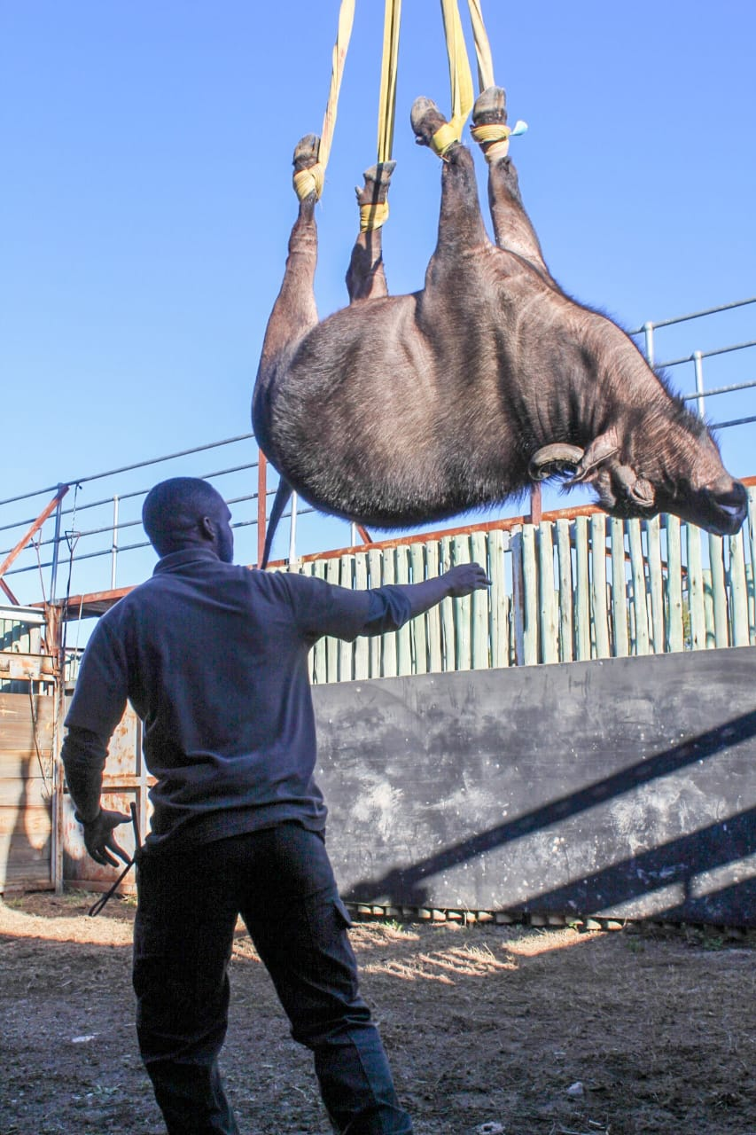
ECOLOGICAL FUNCTIONS
Research
Species Monitoring
Data Management
Game Capture
Species of special concern management (Leopards, Rhinos, Cycads etc)

Slide 11
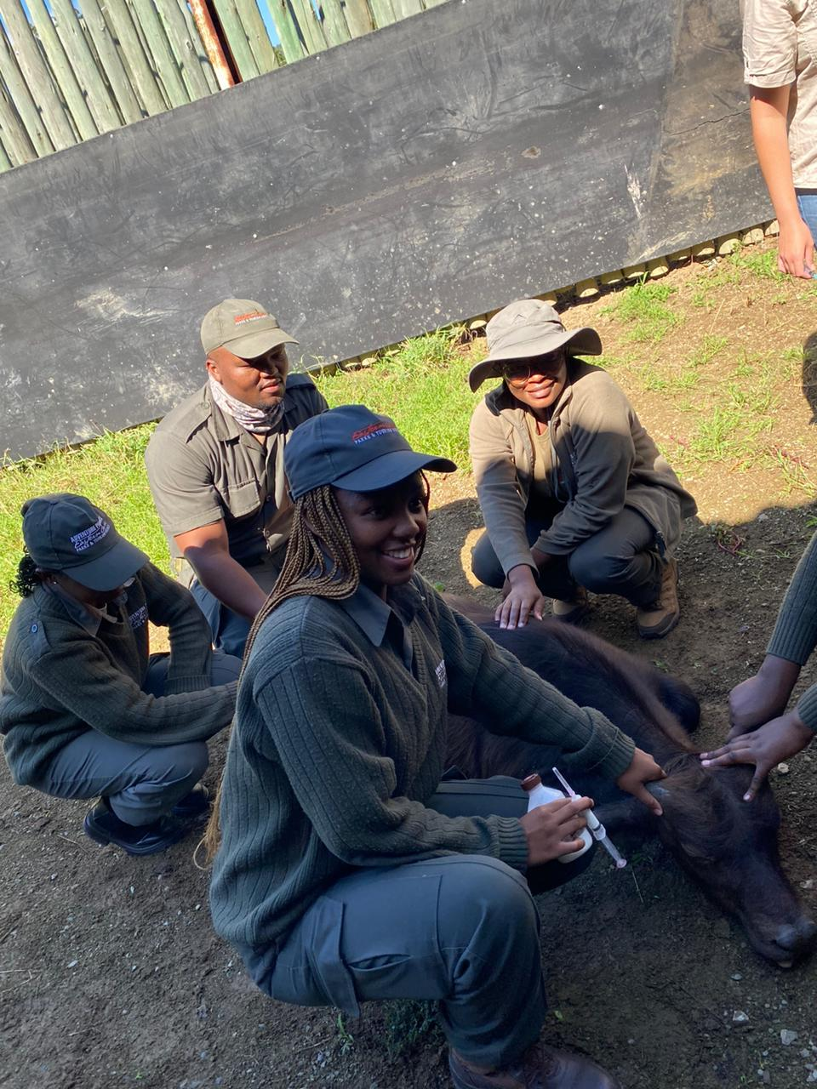
SKILLS DEVELOPMENT
Bursaries for local students adjacent to 50 Km radius from Nature Reserves to pursue Conservation Diploma.
Offer Internships for University Students pursuing conservation related studies. We further offer Work Integrated Learning and Tourism.

Slide 12
SKILLS DEVELOPMENT
We further offer Work Integrated Learning for Students from TVET Colleges pursuing Tourism and support financial management, Human resources qualifications ,etc)

Slide 13
SKILLS DEVELOPMENT
In order for students to qualify for placement, a letter from the institution accompanied by CV is required.

Slide 14
FOR ENQUIRIES
Ms. Faith Duze
Skills Development Officer
Faith.duze@ecpta.co.za

Slide 15
Thank You Siyabulela Baie Dankie

